Slide 1
BCSE306
Artificial Intelligence
Dr.Priyanka N
Assistant Professor Senior Grade-1
School of Computer Science and Engineering (SCOPE),
VIT Vellore,
Priyanka.n@vit.ac.in

Slide 2
Module-7
LANGUAGE MODELS

Slide 3
LANGUAGE
Formal languages, such as the programming languages Java or Python, have precisely defined LANGUAGE language models.
A language can be defined as a set of strings; "print ( 2 + 2" is a legal program in the language Python, whereas "2 )+( 2 print" is not.
Since there are an infinite number of legal programs, they cannot be enumerated; instead, they are specified by a set of rules called grammar.
Natural languages are also ambiguous.
Example: "He saw her duck" can mean either that he saw a waterfowl belonging to her, or that he saw her move to evade something.

Slide 4
N-gram character models
A sequence of written symbols of length n is called an n-gram, with the special case "unigram" for 1-gram, "bigram" for 2-gram, and "trigram" for 3-gram.
A model of the probability distribution of n-letter sequences is thus called an n-gram model.
An n-gram model is defined as a Markov chain of order n-1.

Slide 5
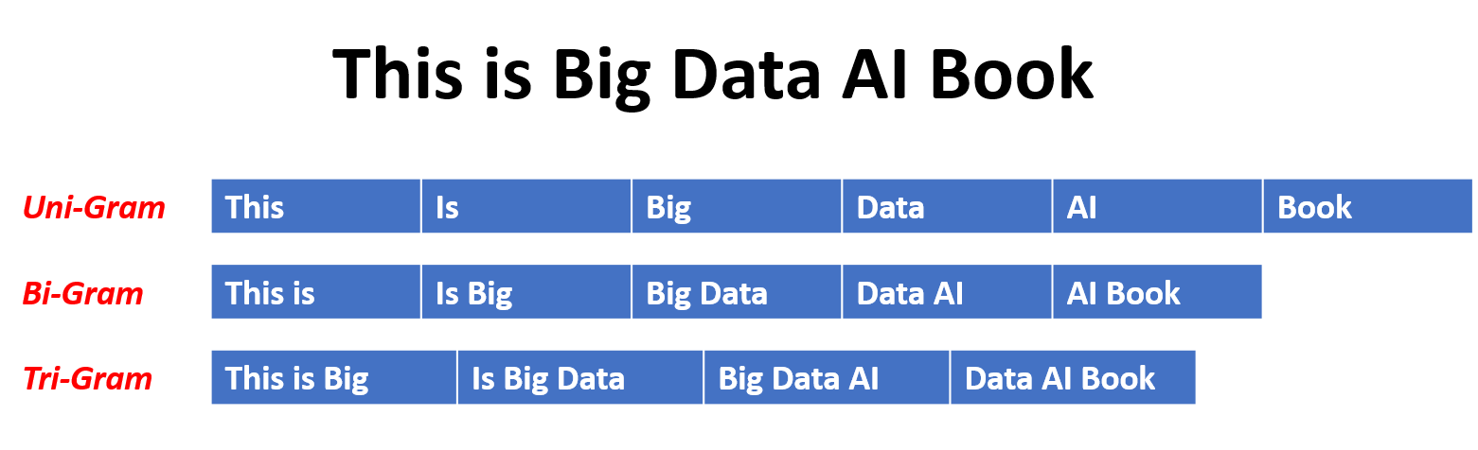
N-gram character models
Given a sequence of N-1 words, an N-gram model predicts the most probable word that might follow this sequence.
It's a probabilistic model that's trained on a corpus of text (large and unstructured set of texts).
This model is useful in many NLP applications including speech recognition, machine translation, and predictive text input.

Slide 6
N-gram character models
An N-gram model is built by counting how often word sequences occur in corpus text and then estimating the probabilities.
An N-gram model is one type of a Language Model (LM), which is about finding the probability distribution over word sequences

Slide 7
N-gram character models
Example:
Consider two sentences: "There was heavy rain" vs. "There was heavy flood". From experience, we know that the former sentence sounds better.
An N-gram model will tell us that "heavy rain" occurs much more often than "heavy flood" in the training corpus.
Thus, the first sentence is more probable and will be selected by the model.

Slide 8
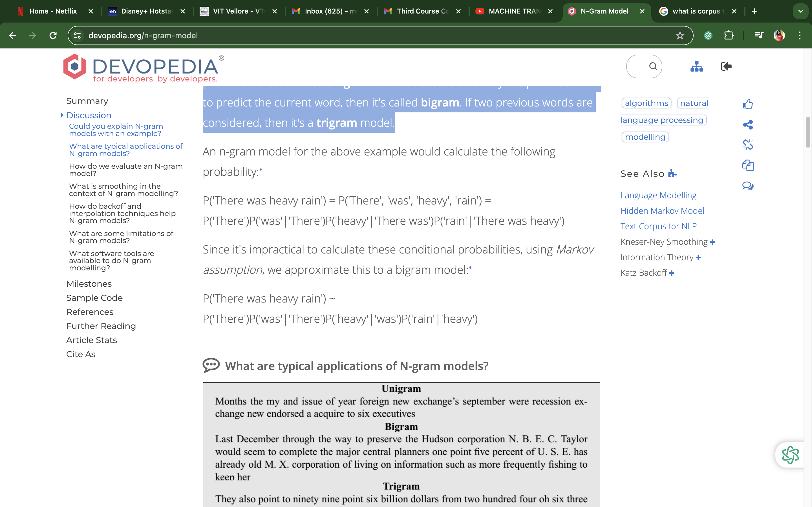
N-gram character models
A model that simply relies on how often a word occurs without looking at previous words is called unigram.
If a model considers only the previous word to predict the current word, then it's called bigram.
If two previous words are considered, then it's a trigram model.

Slide 9
N-gram character models
A common metric is to use perplexity, often written as PP.
Given a test set W=w₁w₂…w_{n}, PP(W)=P(w₁w₂…w_{n})^{−1/N}.
Because of the inverse relationship with probability, minimizing perplexity implies maximizing the test set probability.

Slide 10
Smoothing n-gram models
The usual way to solve this is to give non-zero counts to N-grams that are seen in testing but not in training.
We can't just add 1 to all the zero counts since the overall probability distribution will not be normalized.
Instead, we remove some probability mass from non-zero counts (called discounting) and add them to the zero counts.
The overall process is called Smoothing.

Slide 11
Smoothing n-gram models
Some word sequences may occur in test data that were never seen during training.
When this happens, the probability of the sequence equals zero.
Evaluation is also difficult since the perplexity metric becomes infinite.

Slide 12
Text classification in NLP
Text Classification is the processing of labeling or organizing text data into groups.
It forms a fundamental part of Natural Language Processing.
In the digital age that we live in we are surrounded by text on our social media accounts, in commercials, on websites, Ebooks, etc.
The majority of this text data is unstructured, so classifying this data can be extremely useful.

Slide 13
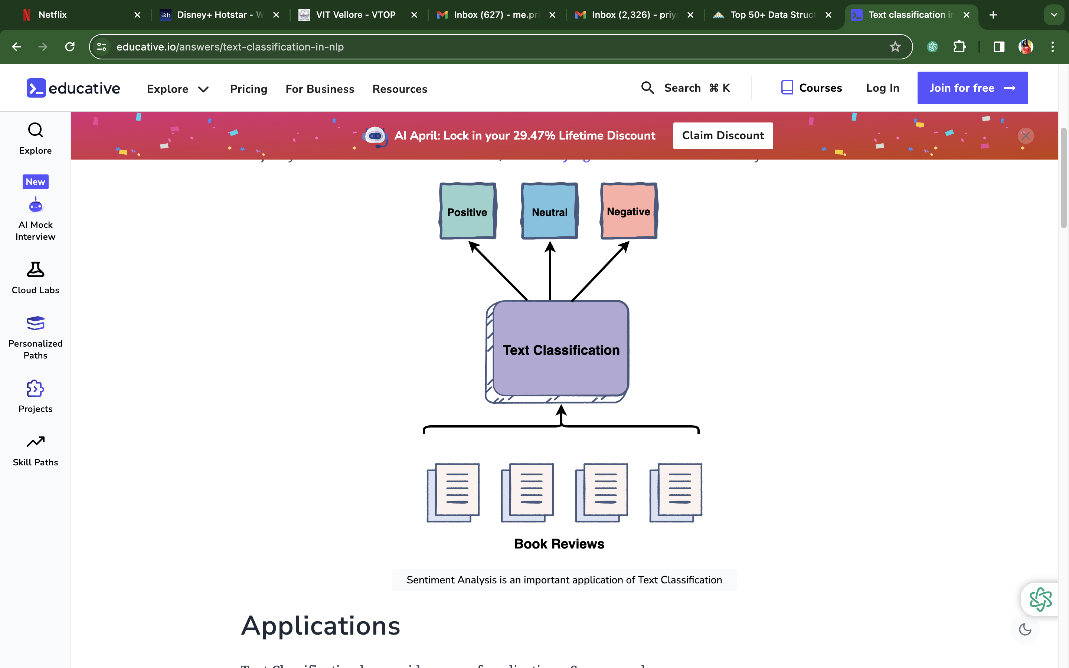
Text classification in NLP

Slide 14
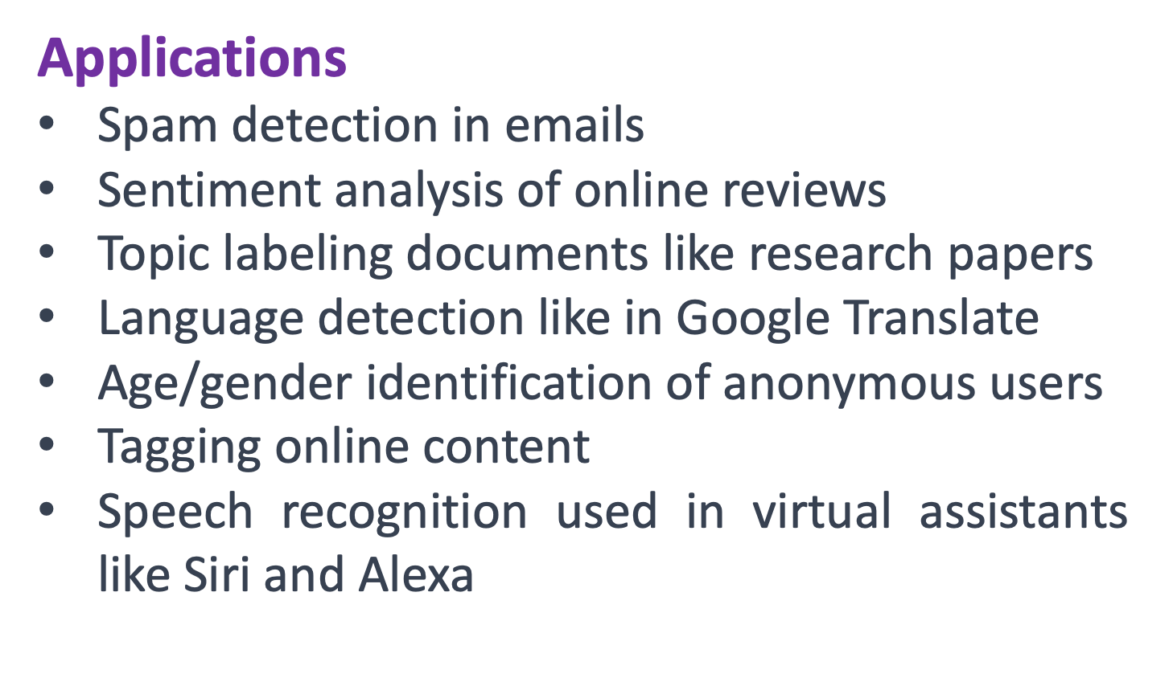
Text classification in NLP

Slide 15
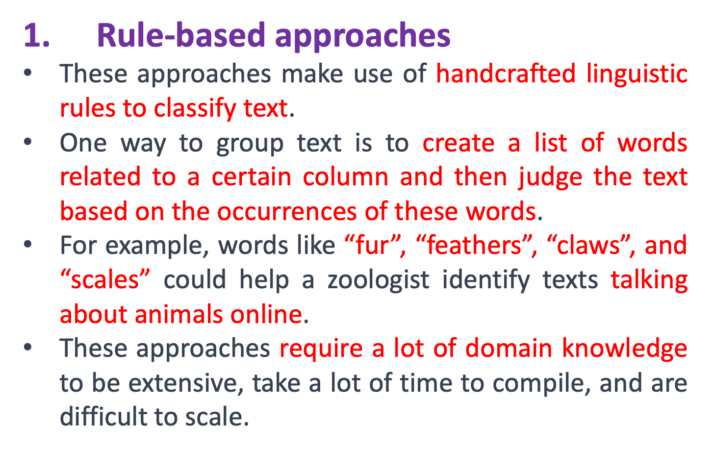
Text classification in NLP

Slide 16
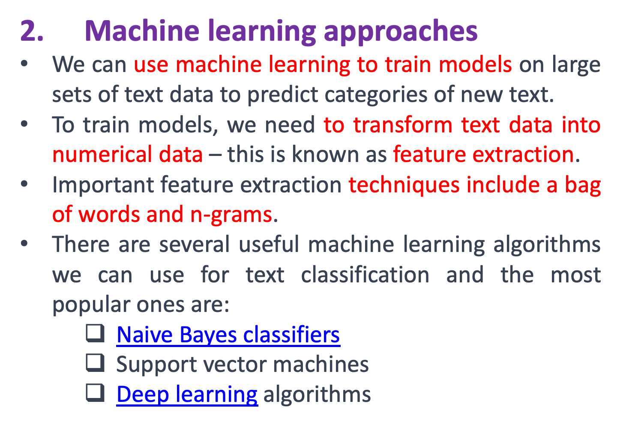
Text classification in NLP

Slide 17
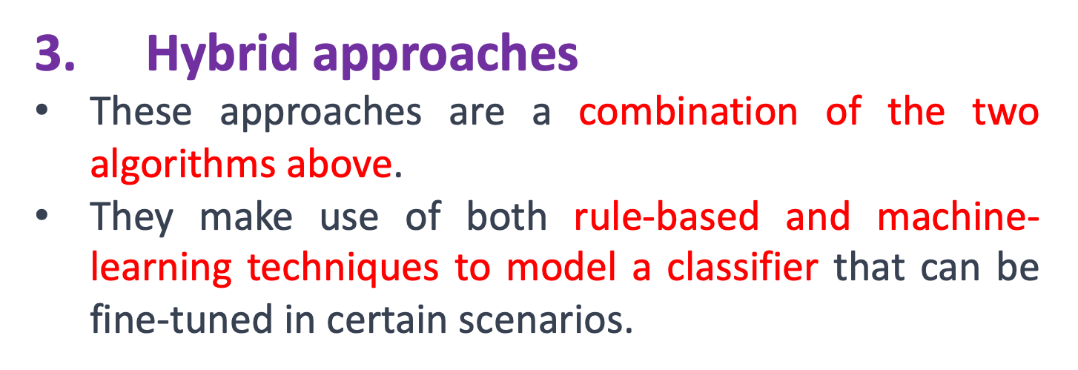
Text classification in NLP

Slide 18
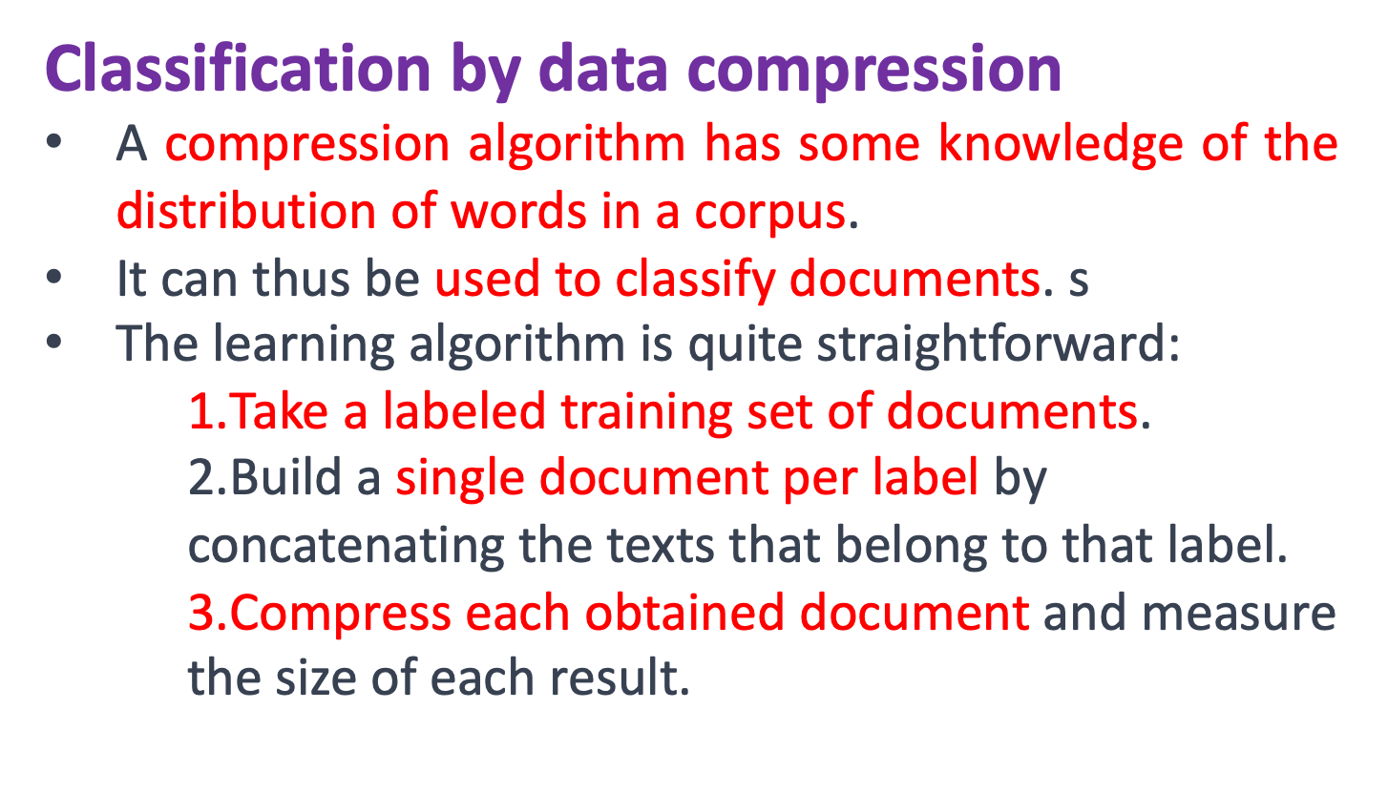
Text classification in NLP

Slide 19
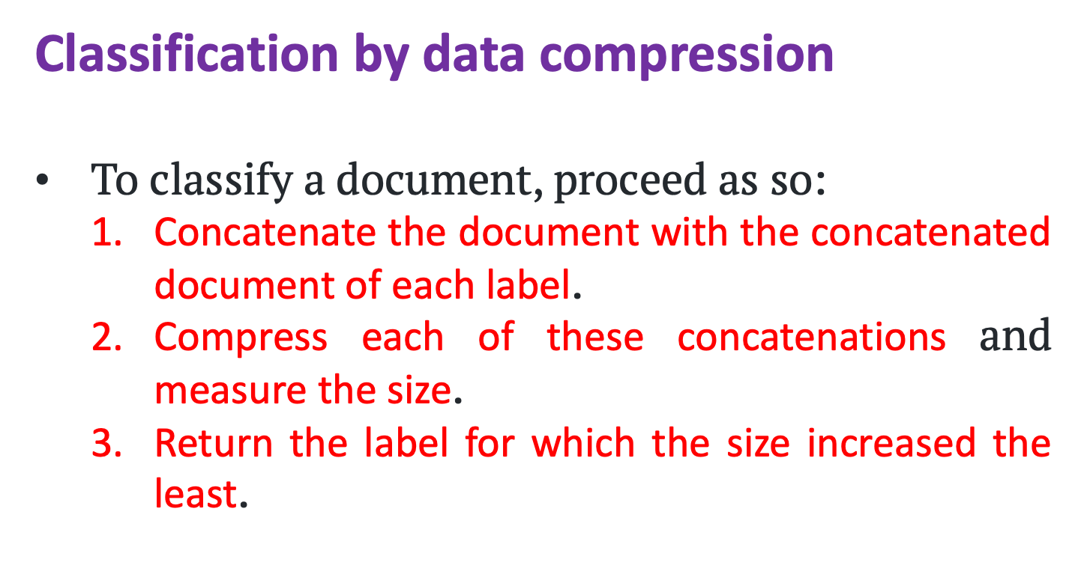
Text classification in NLP

Slide 20
Information retrieval
Information retrieval (IR) may be defined as a software program that deals with the organization, storage, retrieval, and evaluation of information from document repositories particularly textual information.
The system assists users in finding the information they require but it does not explicitly return the answers to the questions.

Slide 21
Information retrieval
It informs the existence and location of documents containing the required information.
The documents that satisfy the user’s requirement are called relevant documents.
A perfect IR system will retrieve only relevant documents.

Slide 22
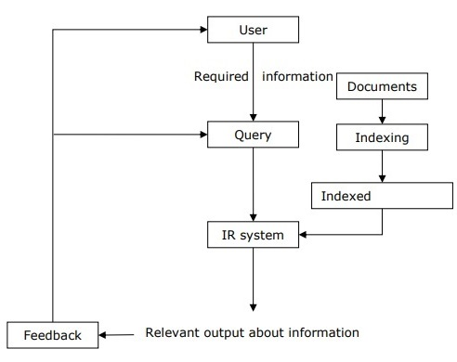
Information retrieval

Slide 23
Information retrieval Model
Mathematically, models are used in many scientific areas having an objective to understand some phenomenon in the real world.
IR model consists of the following:
A model for documents.
A model for queries.
A matching function that compares queries to documents.

Slide 24
Information retrieval Model
Mathematically, a retrieval model consists of −
    D − Representation for documents.
    R − Representation for queries.
    F − The modeling framework for D, Q along with the relationship between them.
R (q,di) − A similarity function that orders the documents concerning the query.
It is also called ranking.

Slide 25
Types of Information retrieval Model
Classical IR Model
  It is the simplest and easiest to implement the IR model.
  This model is based on mathematical knowledge that was easily recognized and understood as well.
  Boolean, Vector, and Probabilistic are the three classical IR models.

Slide 26
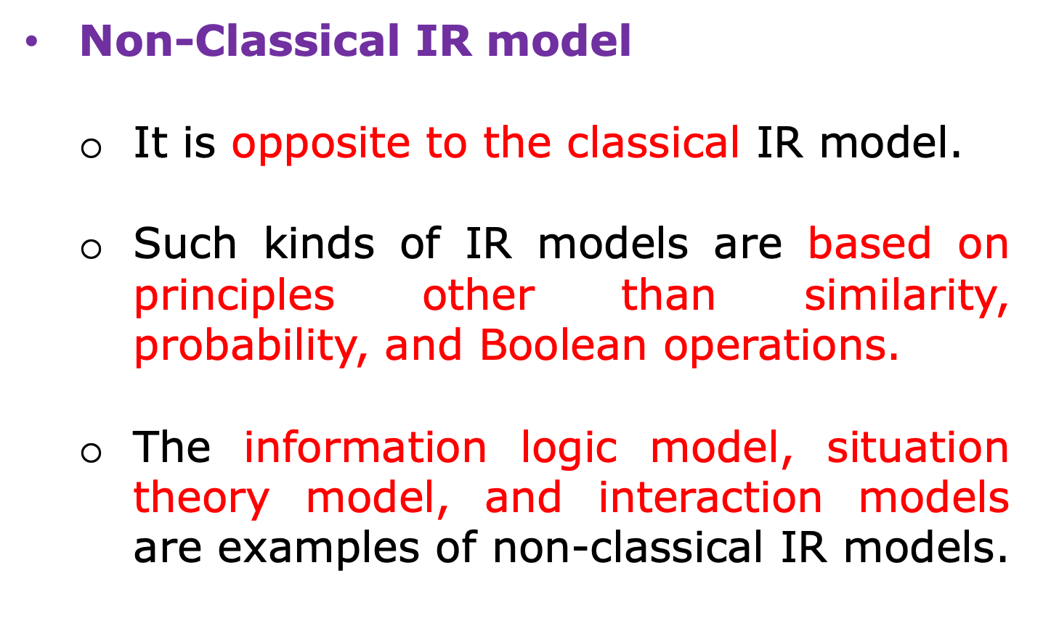
Types of Information retrieval Model

Slide 27
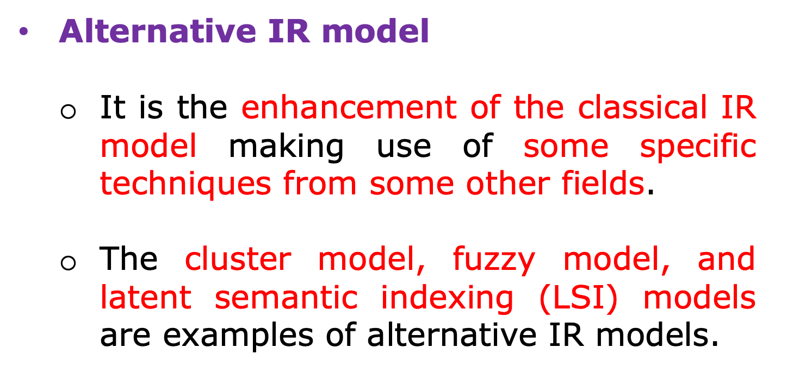
Types of Information retrieval Model

Slide 28
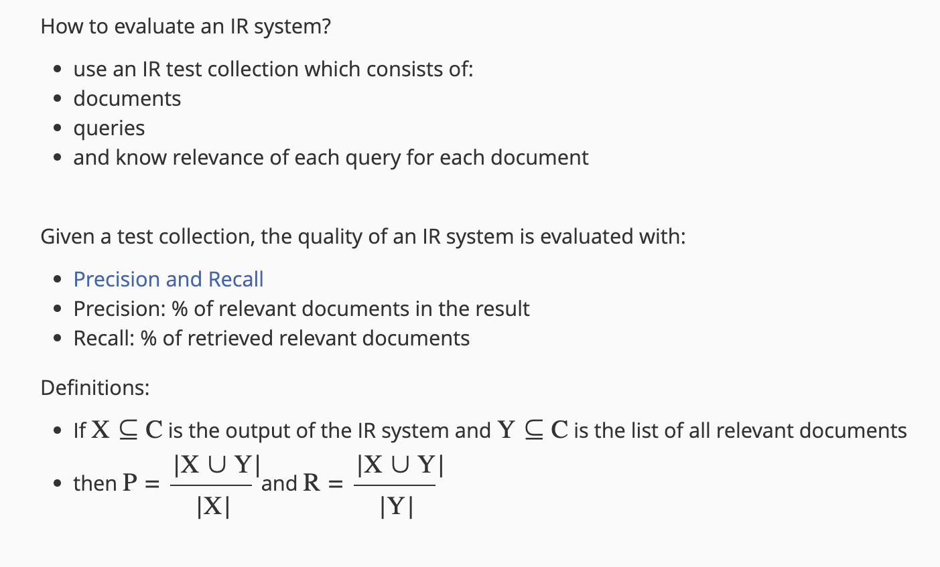
Evaluation

Slide 29
Page rank algorithm
PageRank (PR) is an algorithm used by Google Search to rank websites in their search engine results.
PageRank was named after Larry Page, one of the founders of Google.
PageRank is a way of measuring the importance of website pages.

Slide 30
Page rank algorithm
According to Google:
  PageRank works by counting the number and quality of links to a page to determine a rough estimate of how important the website is.

